Slide 1
Approaches on Training Quality Improvement for Resource Constrained Edge Intelligence
LIU Yi (Ph.D. Student)
GUO Song (Supervisor)
Department of Computing
The Hong Kong Polytechnic University

Slide 2






Booming Era of Deep Learning
Smart Health
Smart Surveillance
Smart Home
Self-Driving
Smart Grid
Multimedia Service
Smart Decision Making, Automation, and Optimization
Big Data
Deep Learning

Slide 3






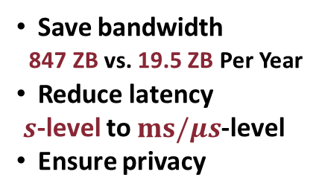
From Cloud Intelligence to Edge Intelligence
Cloud Intelligence
Edge Intelligence
Cloud
Cloud
Model Training &
Inference
Model Training &
Inference
Edge
Save bandwidth
847 ZB vs. 19.5 ZB Per Year
Reduce latency
$s$-level to $ms/μs$-level
Ensure privacy
Model Training &
Inference

Slide 4
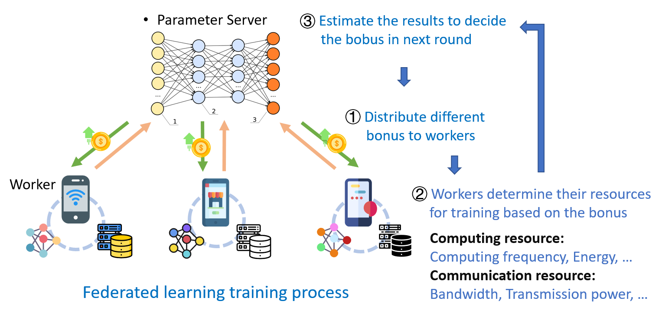
Incentive Mechanism for Edge Learning
Sustaining heterogeneous workers to participate distributed edge learning is difficult because huge costs are incurred when joining the system, which brings a need for incentive mechanisms.
Limitations of Existing work
Only consider myopia optimization of single round
Unable to guarantee the quality of the final machine learning model

Slide 5
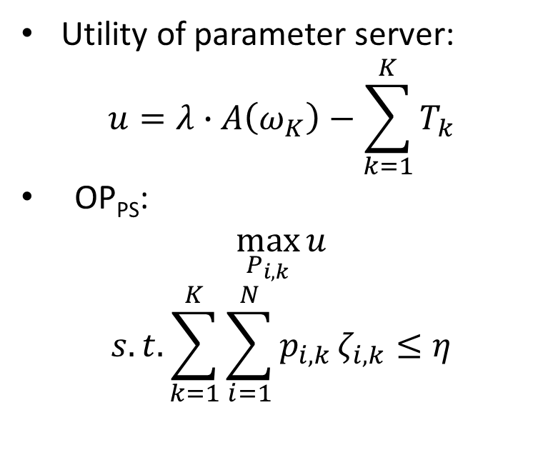
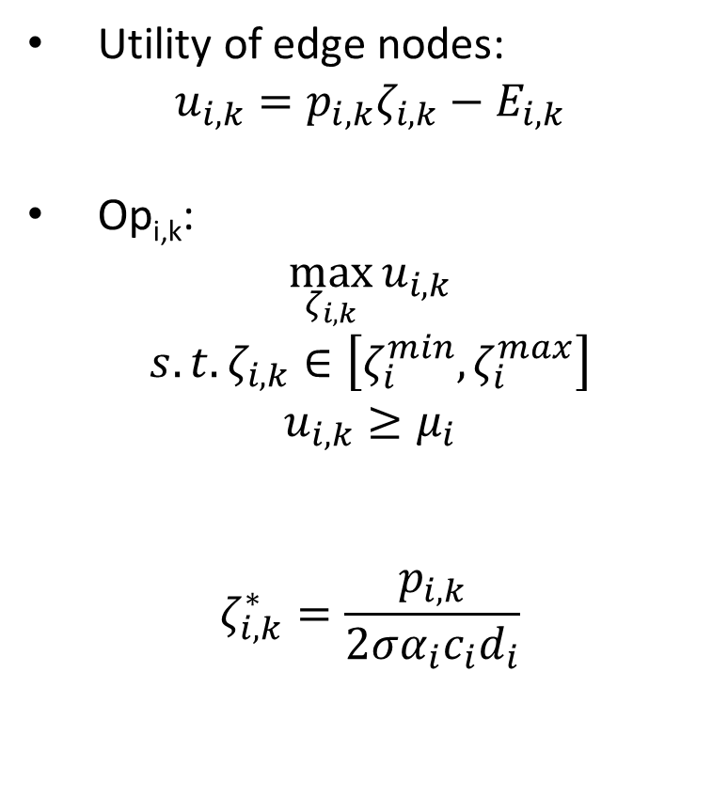
Problem Formulation
Utility of edge nodes:
$$u_{i,k}=p_{i,k}ζ_{i,k}−E_{i,k}$$
Op_{i,k}:
$$\max_{ζ_{i,k}}{u_{i,k}}$$
$$s.t. ζ_{i,k}∈\left[ζ_{i}^{min},ζ_{i}^{max}\right]$$
$$u_{i,k}≥μ_{i}$$
$$ζ_{i,k}^{∗}=\frac{p_{i,k}}{2σα_{i}c_{i}d_{i}}$$
Utility of parameter server:
$$u=λ∙A\left(ω_{K}\right)−\sum_{k=1}^{K}{T_{k}}$$
OP_{PS}:
$$\max_{P_{i,k}}{u}$$
$$s.t. \sum_{k=1}^{K}{\sum_{i=1}^{N}{p_{i,k}}}ζ_{i,k}≤η$$
Due to the characteristic opacity of Federated Learning, we can not directly compute the optimal pricing solution for parameter server. Hence, we applied experience-driven DRL methods.

Slide 6
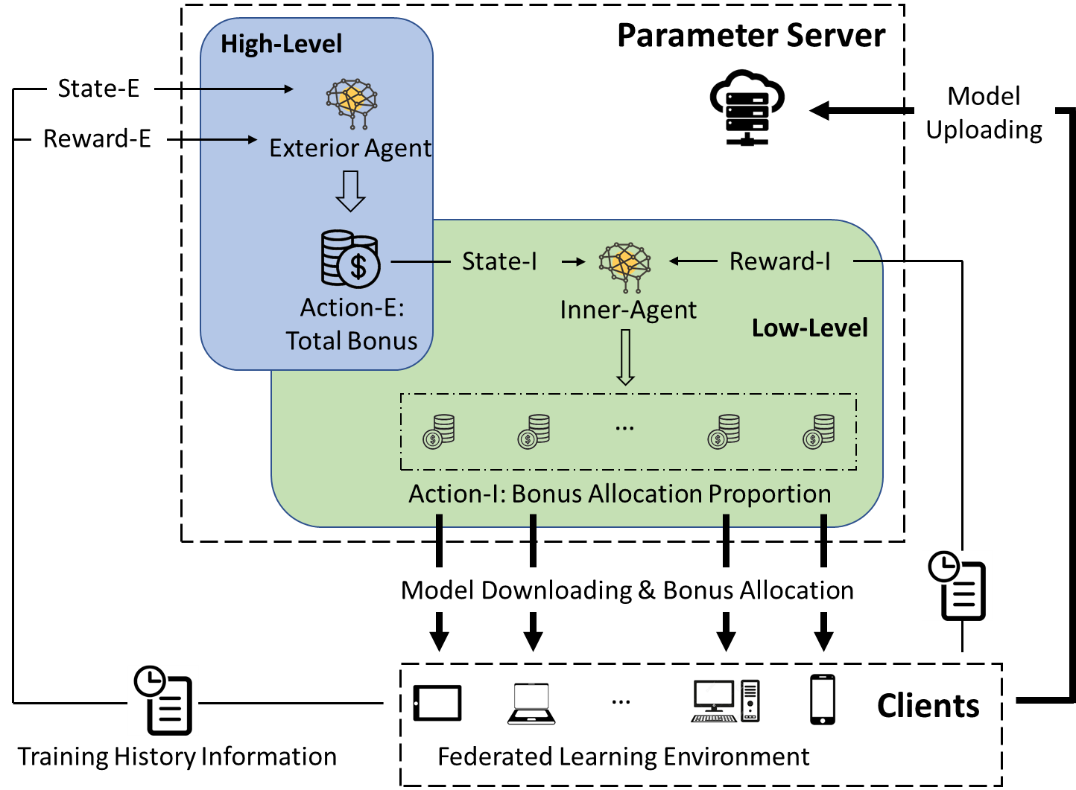
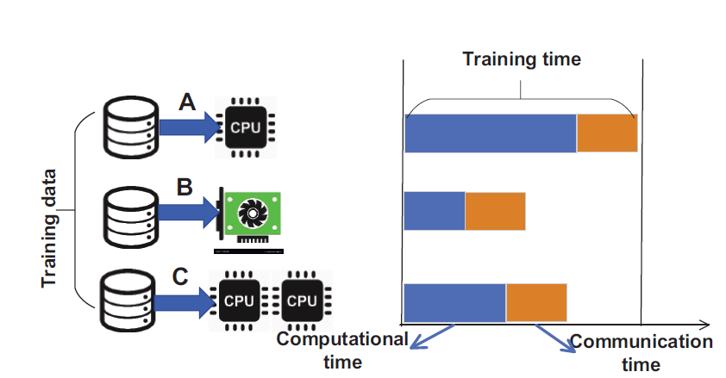
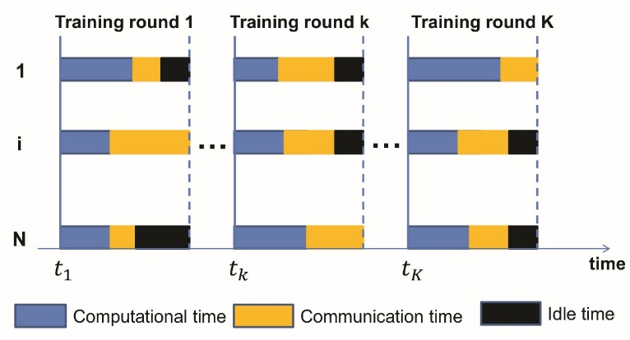
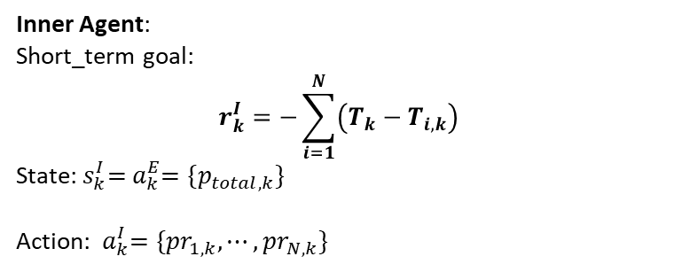
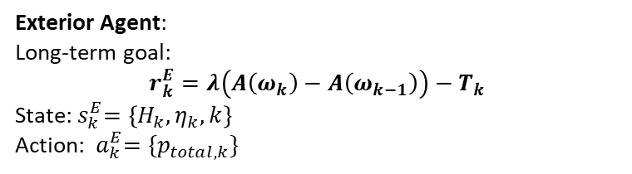
Chiron: Hierarchical DRL Model
Exterior Agent:
Long-term goal:
$$r_{k}^{E}=λ\left(A\left(ω_{k}\right)−A\left(ω_{k−1}\right)\right)−T_{k}$$
State:${ s}_{k}^{E}=\left\{H_{k}, η_{k}, k\right\}$
Action: ${ a}_{k}^{E}=\{p_{total,k}\}$
Inner Agent:
Short_term goal:
$$r_{k}^{I}=−\sum_{i=1}^{N}{\left(T_{k}−T_{i,k}\right)}$$
State:${ s}_{k}^{I}={ a}_{k}^{E}=\{p_{total,k}\}$
Action: ${ a}_{k}^{I}=\{{pr}_{1,k}, ⋯,{pr}_{N,k}\}$

Slide 7
Experiments Performance
Our incentive-driven DRL approach achieves higher accuracy and time efficiency with the same budget.
Model Accuracy
Training Rounds
Time Efficiency

Slide 8
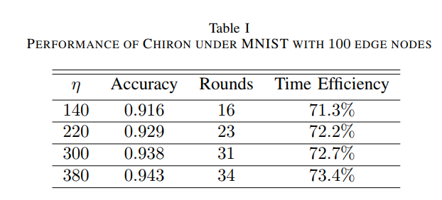
Experiments Performance
Our hierarchical DRL model design also shows more scalability
100 clients’ Experiments
DRL-based approach
Chiron

Slide 9
Conclusions
This is the first work to design the incentive-driven edge learning, which takes the learning algorithm performance into the incentive mechanism design.
We proposed a hierarchical DRL-based incentive mechanism for the edge learning. Without knowing any prior information of the edge nodes, it can effectively learn the optimal pricing strategy of the parameter server and achieve the long-term sustainability of edge learning under a limited budget.
We implement our mechanism in an edge learning simulator developed from scratch and evaluate it under a variety of edge learning tasks. Our experimental results have further demonstrated the superiority of our approach.

Slide 10
Thank you!

